Slide 1
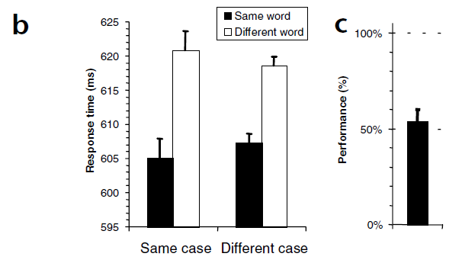
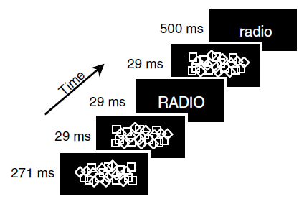
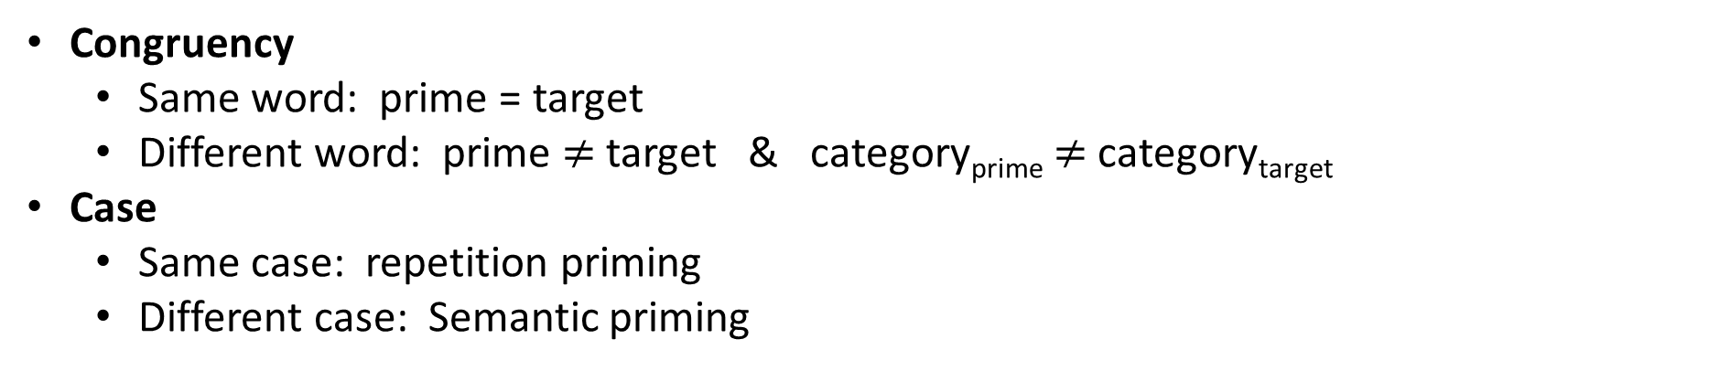
Dehane et al., 2001
Congruency
Same word: prime = target
Different word: prime $≠$ target & category_{prime} $≠$ category_{target}
Case
Same case: repetition priming
Different case: Semantic priming
Forced choice
Dehaene et al., (2001). Cerebral mechanisms of word masking and unconscious repetition priming. Nature neuroscience, 4(7), 752-758.
Notes:
The experiment relies on Dehaene’s paper from 2001.
Where he displayed a masked prime and a target to subjects.
The prime and target were words describing natural / artificial items, and subjects were asked to categorize the target accordingly.
For example, when the target was “radio” they chose “artificial”.
Congruency was manipulated in the experiments such that:
On same word trials the prime and the target were identical,
On different word trials the prime and the target were different words from different category.
The letter case of the target and the prime was also manipulated which allowed to check repetition priming on the same case condition
And semantic priming on the different case condition.
Results:
When we check the response times we can see:
A repetition priming effect (15ms) since RT was quicker when the prime was identical to the target.
A semantic priming effect (12ms) since RT was quicker when the prime and target where the same word but in different font.
______________________________________________________________________________________________
At the end of the experiment subjects performed a force choice recognition task: in which they had to recognize the prime between 2 displayed words.
Forced choice showed that subjects weren’t aware of the prime.
N = 10
40 stimuli words, half nat half art.
Forced choice after priming.
In exp 1:
~~~~~In task 1 they performed a naming task (name prime, if didn’t see specifically what is it, say “seen”)~~~~~
They ran recognition trials before and after imaging but not during. Same for exp 2.
Subjects need to recognize the prime, if saw only something they say “seen”

Slide 2
Experiment design

Slide 3
Man-made Natural
Prime-target relation: Same word
Fixation 1000ms
Man-made Natural
Mask 270ms
Man-made Natural
Mask 30ms
Man-made Natural
RADIO
Prime 30ms
Man-made Natural
Mask 30ms
Man-made Natural
Time
radio
Target + Categorization 500ms
RADIO PHONE
Recognition
How well did you see the first stimuli?
On a scale of 1-4
PAS
1 2 3 4

Slide 4
Man-made Natural
Prime-target relation: Different word
Fixation 1000ms
Man-made Natural
Mask 270ms
Man-made Natural
Mask 30ms
Man-made Natural
CLOUD
Prime 30ms
Man-made Natural
Mask 30ms
Man-made Natural
Time
radio
Target + Categorization 500ms
CLOUD TIGER
Recognition
How well did you see the first stimuli?
On a scale of 1-4
PAS
1 2 3 4

Slide 5
Setup

Slide 6
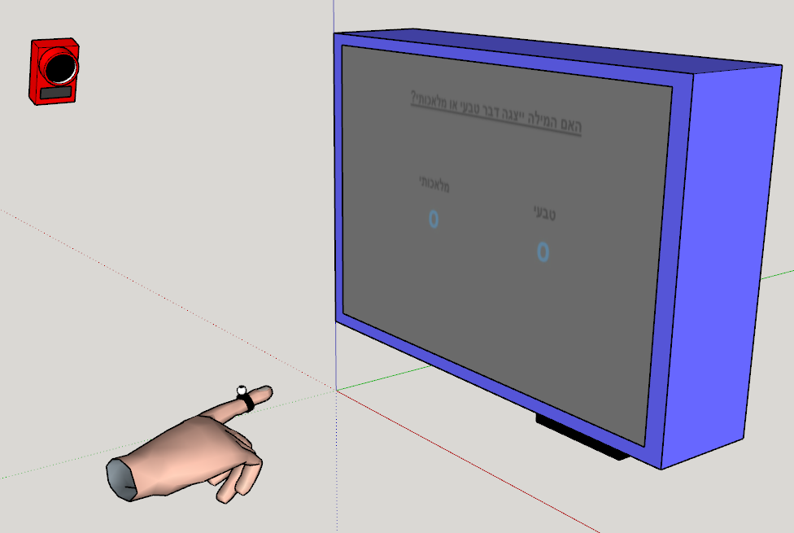

Slide 7
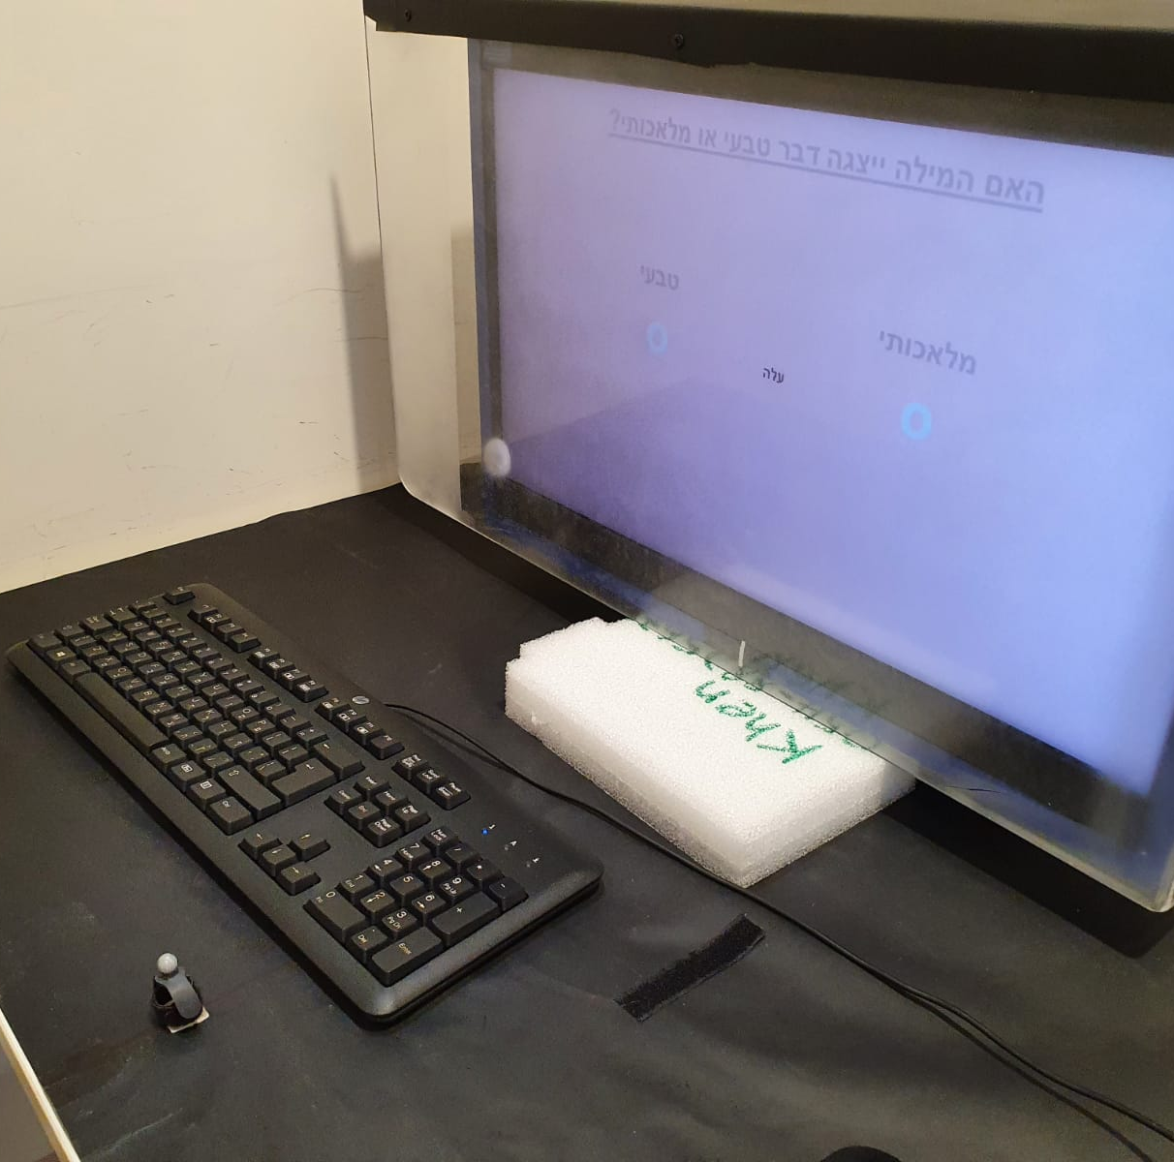
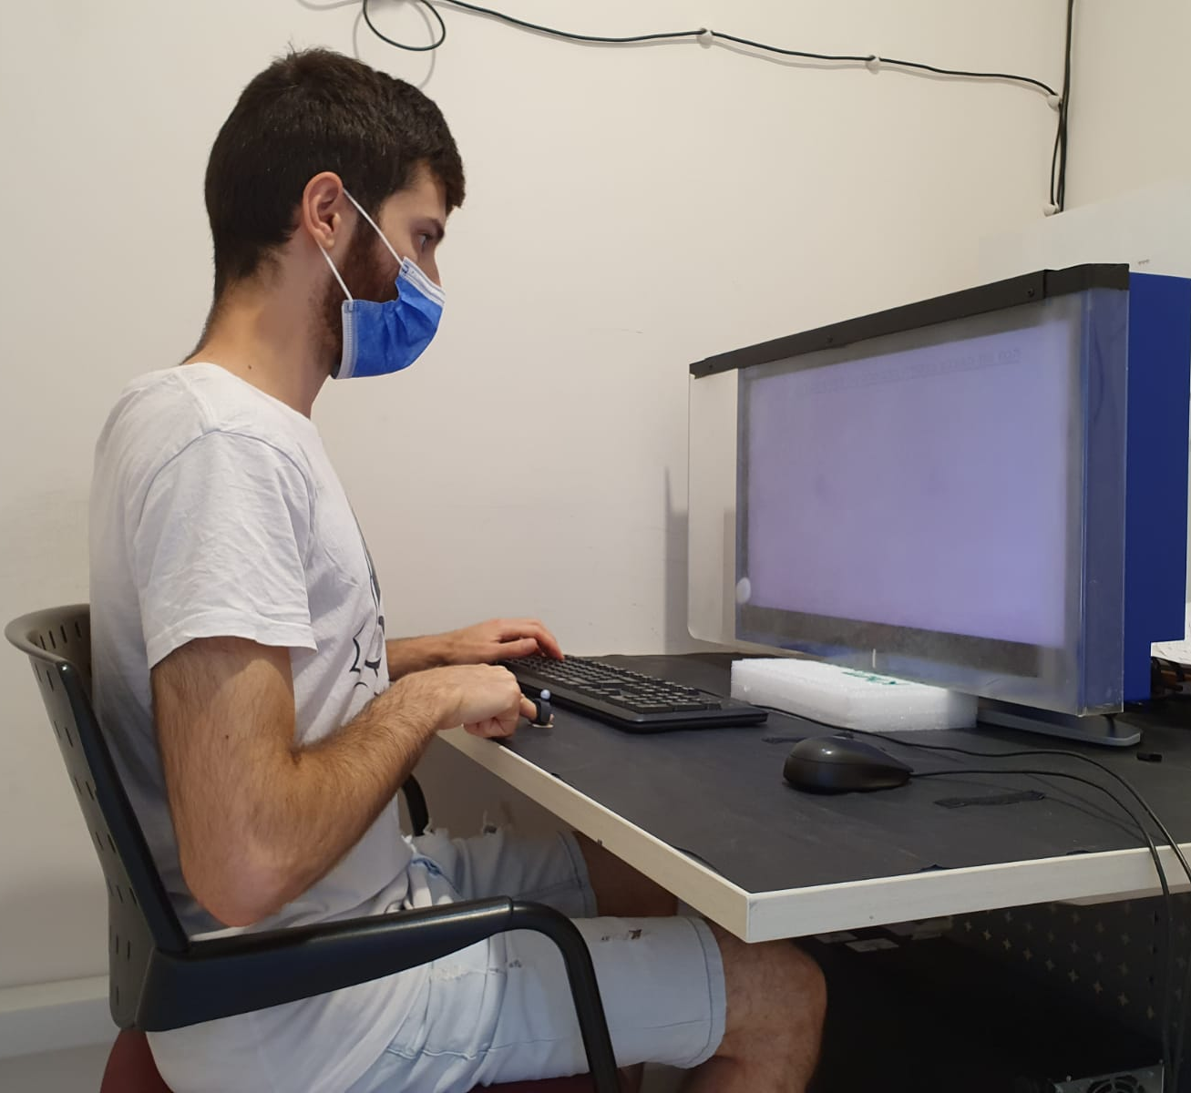
20cm
40cm

Slide 8
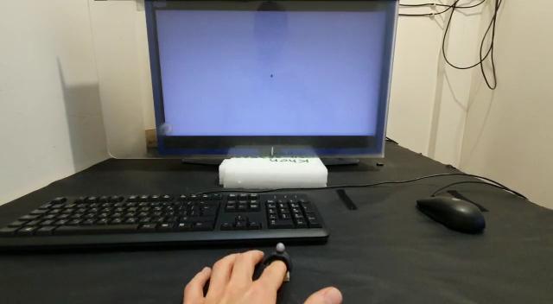
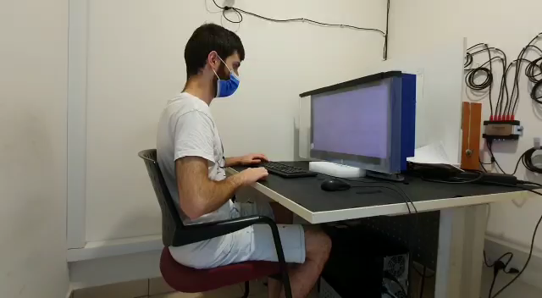

Slide 9
Results

Slide 10
Average Between Subs
Notes:
Divided the results to trials where the correct answer was on the left side and trials where it was on the right side.

Slide 11
Average Between Subs

Slide 12
Average Between Subs

Slide 13
Average Between Subs

Slide 14
Average Between Subs
Notes:
Inserting side of screen as random parameter changes values to NaN.

Slide 15
Single subject

Slide 16
(Sec)

Slide 17
(Sec)

Slide 18
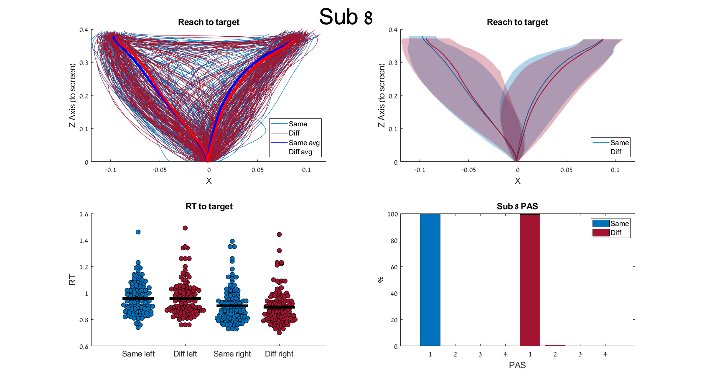
(Sec)

Slide 19
(Sec)

Slide 20
(Sec)

Slide 21
(Sec)

Slide 22
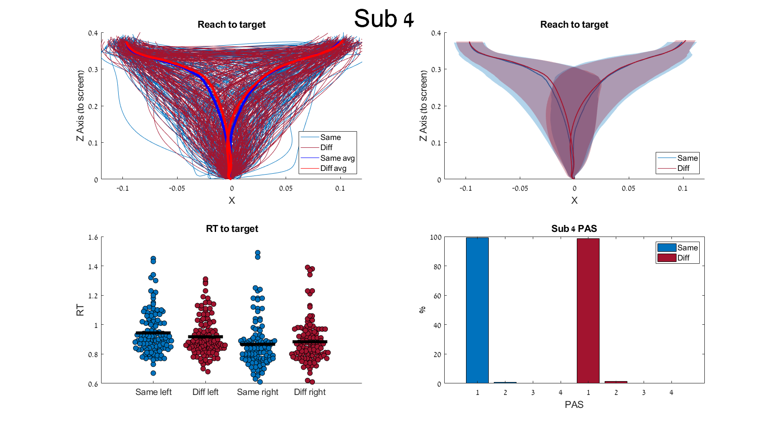
(Sec)

Slide 23
(Sec)

Slide 24
(Sec)

Slide 25
(Sec)

Slide 26
(1)
(2)
(3)
Y
Y
B
3
B
B
2
A
A
interpolated
A
1
X
X
1
2
3

